Slide 1
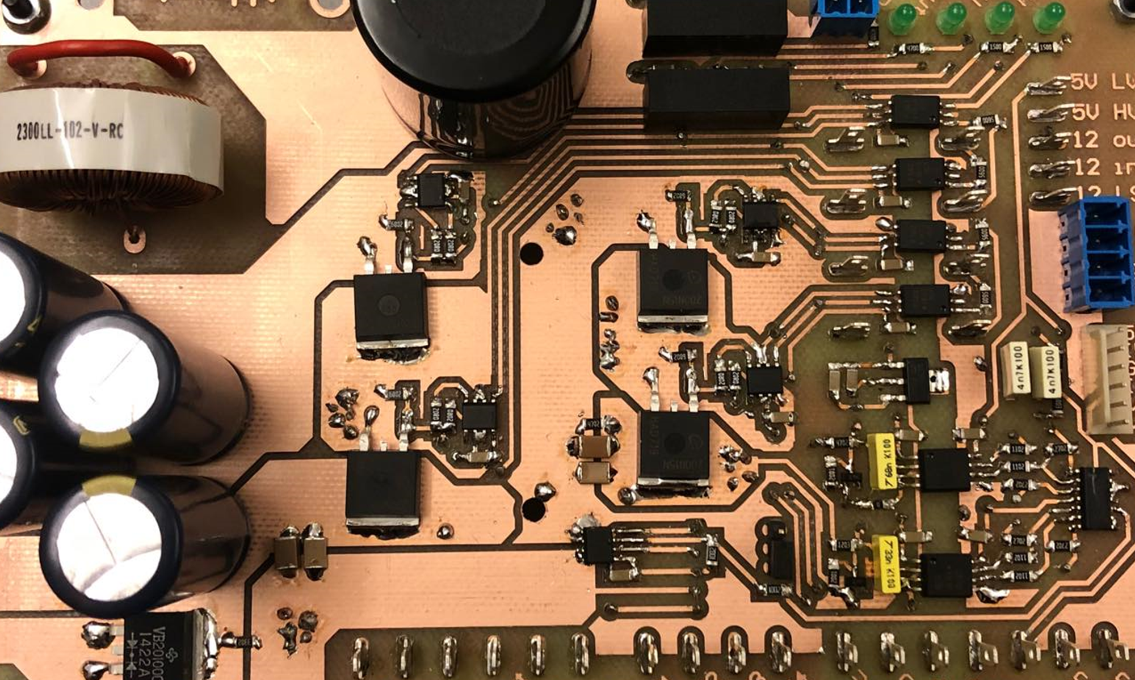
Questions
Notes:
Motivation
Existing problems
What is a MIC
Why a MIC
Problem statement

Slide 2
Open loop control - VF

